Slide 1
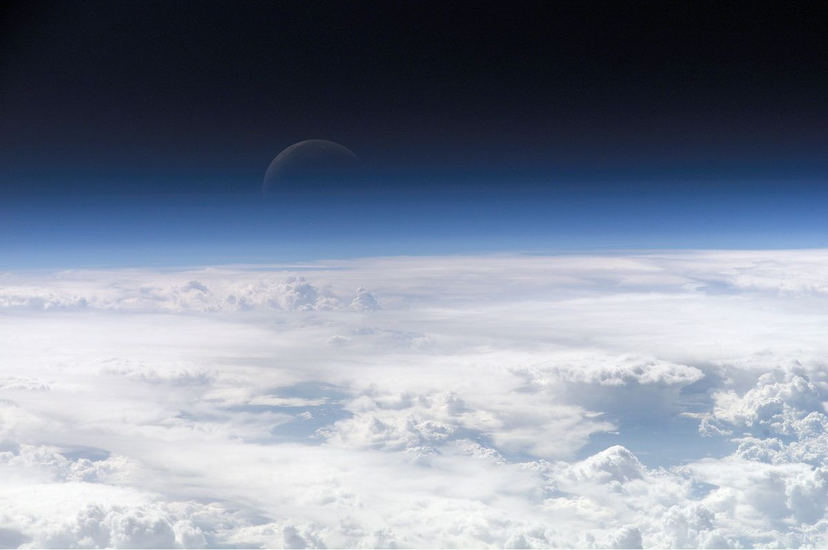
Atmosphere and Air Pollution

Slide 2
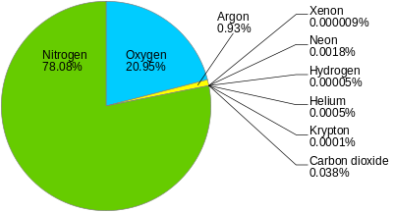
The air!
Most of the atmosphere is made up of only nitrogen and oxygen

Slide 3
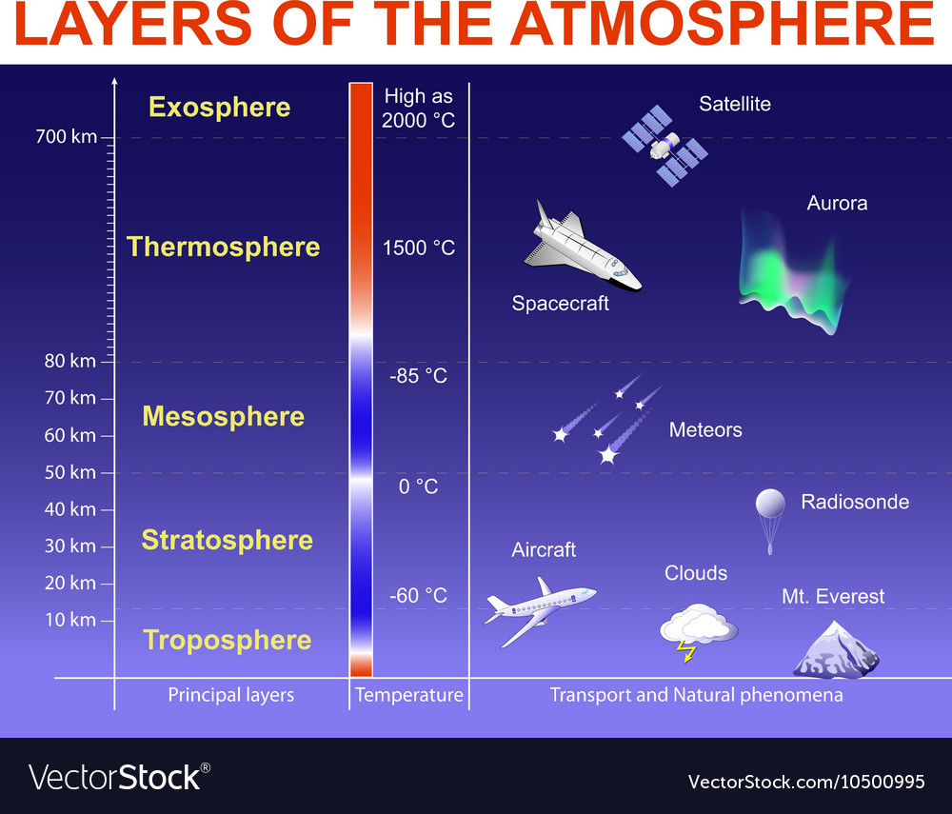

Slide 4
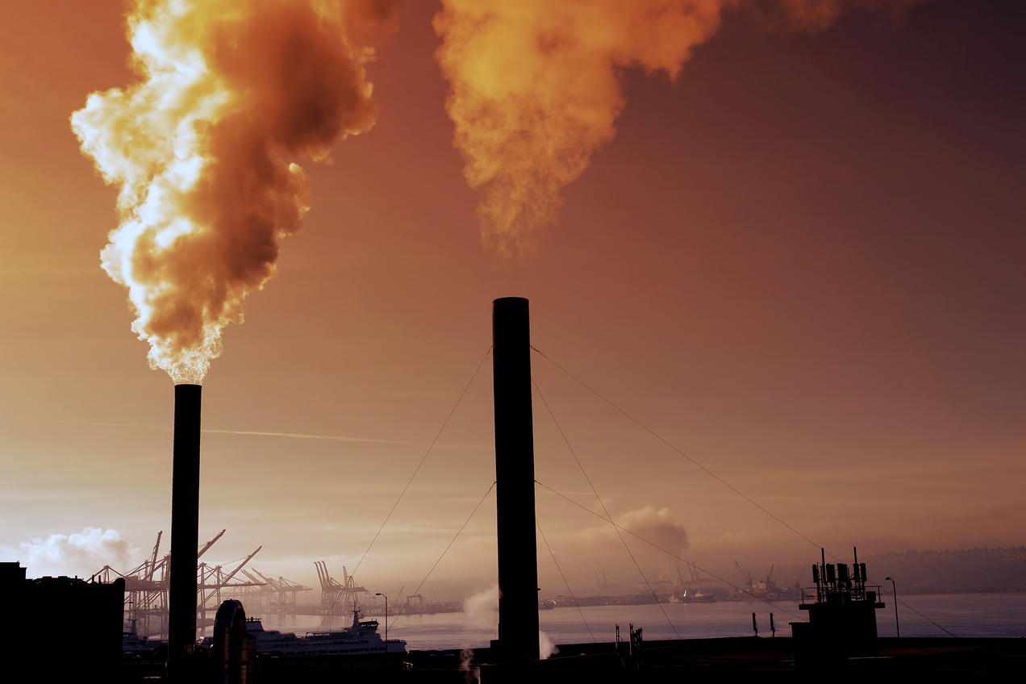
Super cool pollutant video

Slide 5
Pollutants
Primary Pollutants
o Volatile organic compounds (VOCs) such as gases from evaporating gasoline.
o Carbon monoxide (CO), which is an odorless gas that is produced by combustion.
o NO_{x}, which includes nitric oxide (NO) and nitrogen dioxide (NO₂).
o Sulfur dioxide (SO₂), which is produced through the combustion of coal.
o Particulate matter (PM), which are small suspended particles.
o Lead, which we used to add to our gasoline.
Secondary Pollutants
o NO_{x} can produce nitric acid (HNO₃).
o Sulfur dioxide (SO₂) can produce sulfuric acid (H₂SO₂).
o Ozone (O₃), which is produced through chemical reactions between nitrogen dioxide, VOCs, and sunlight.

Slide 6

BREAKOUT!

Slide 7
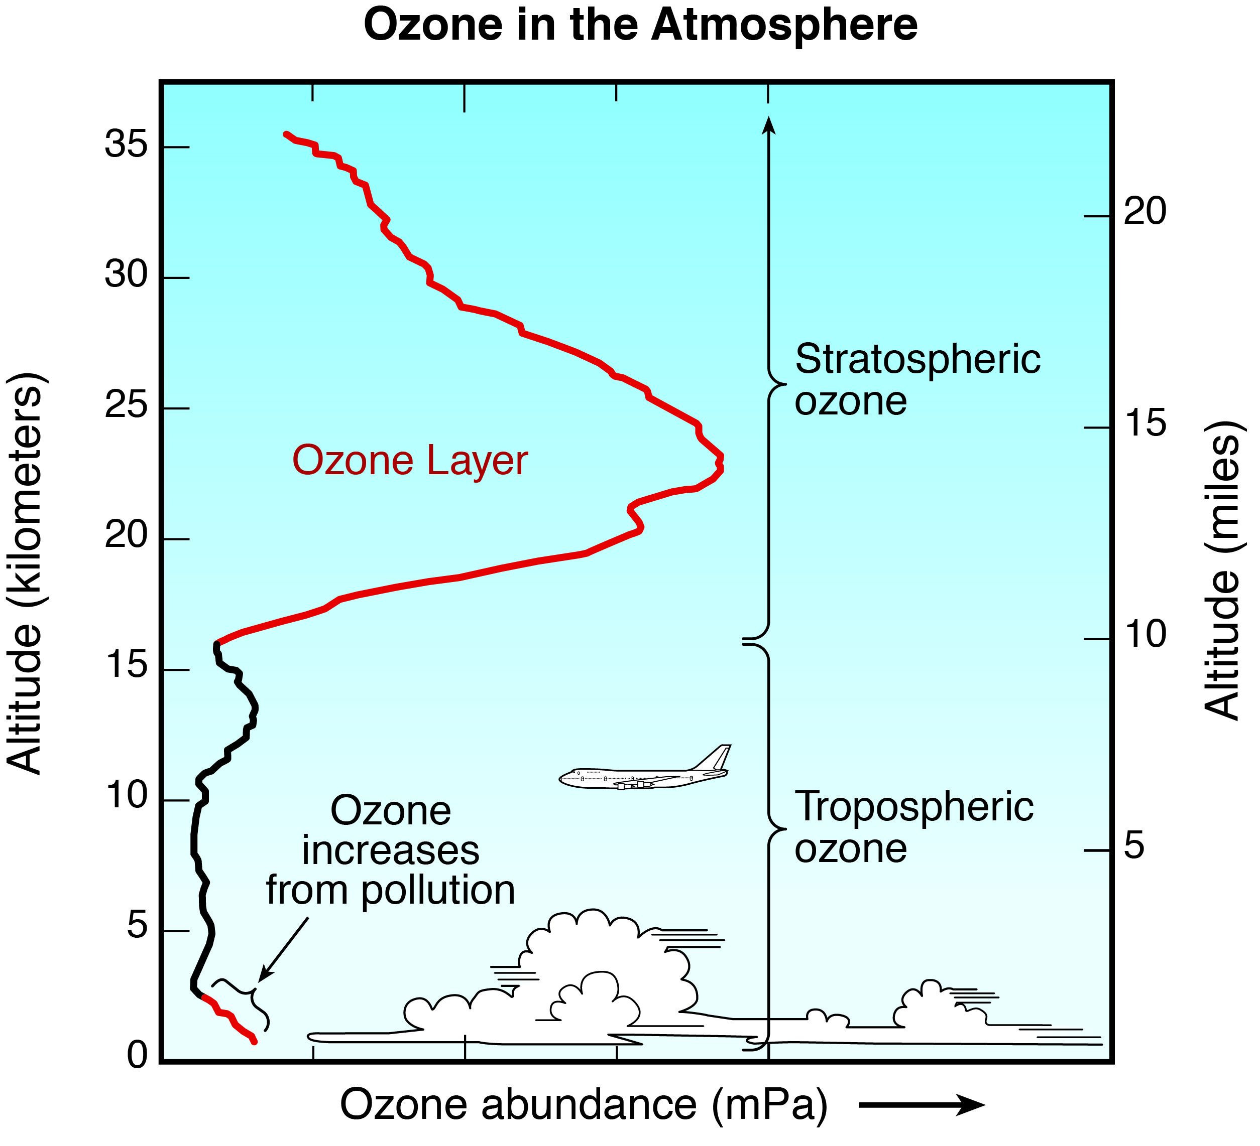

Slide 8
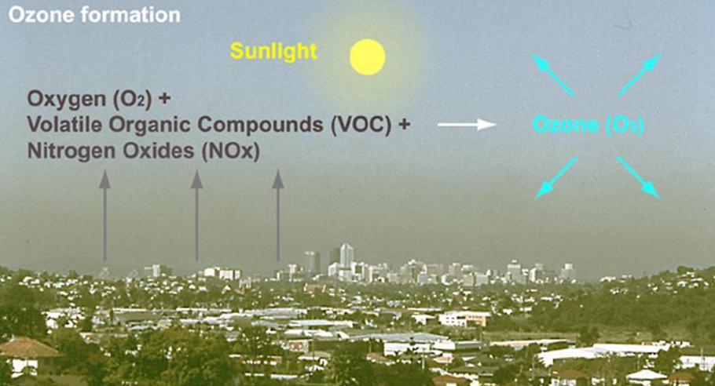
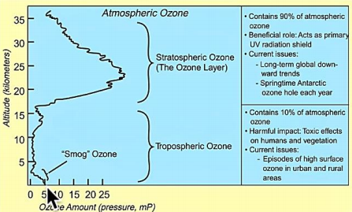
Ozone can be helpful or harmful to our health and the environment. In the stratosphere, ozone is produced naturally to block harmful ultraviolet rays from the sun. This is an example of “good” ozone. In the troposphere, ground-level ozone largely contributes to smog. This is “bad” ozone.

Slide 9
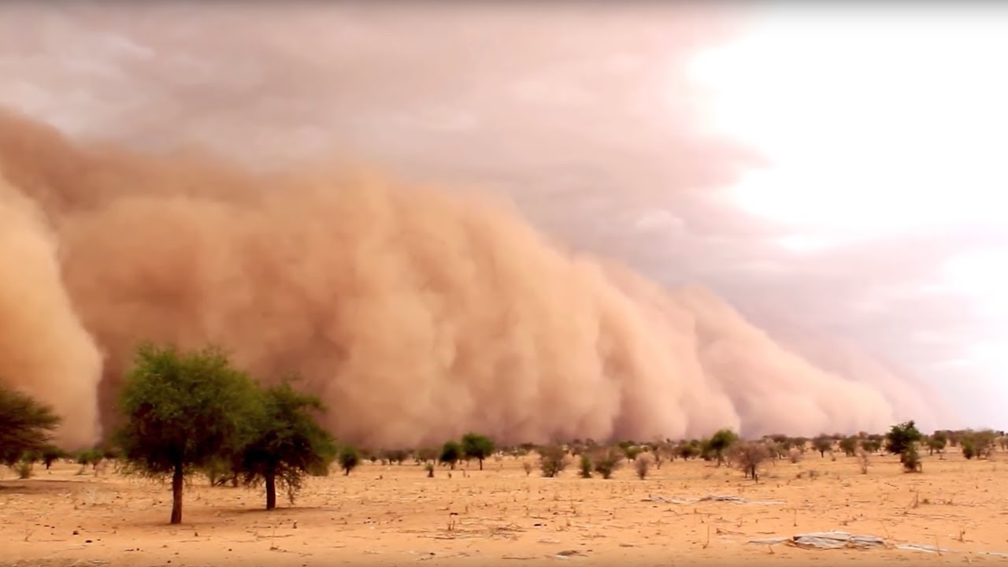
Aerosols
Come from volcanic eruptions, wildfires, sandstorms,
and other natural causes . There are also be man-made
sources such as controlled burning, car exhaust fumes, and industrial pollution.
Our weather, climate, the whole thermal state of our planet, and our health is influenced by aerosols

Slide 10
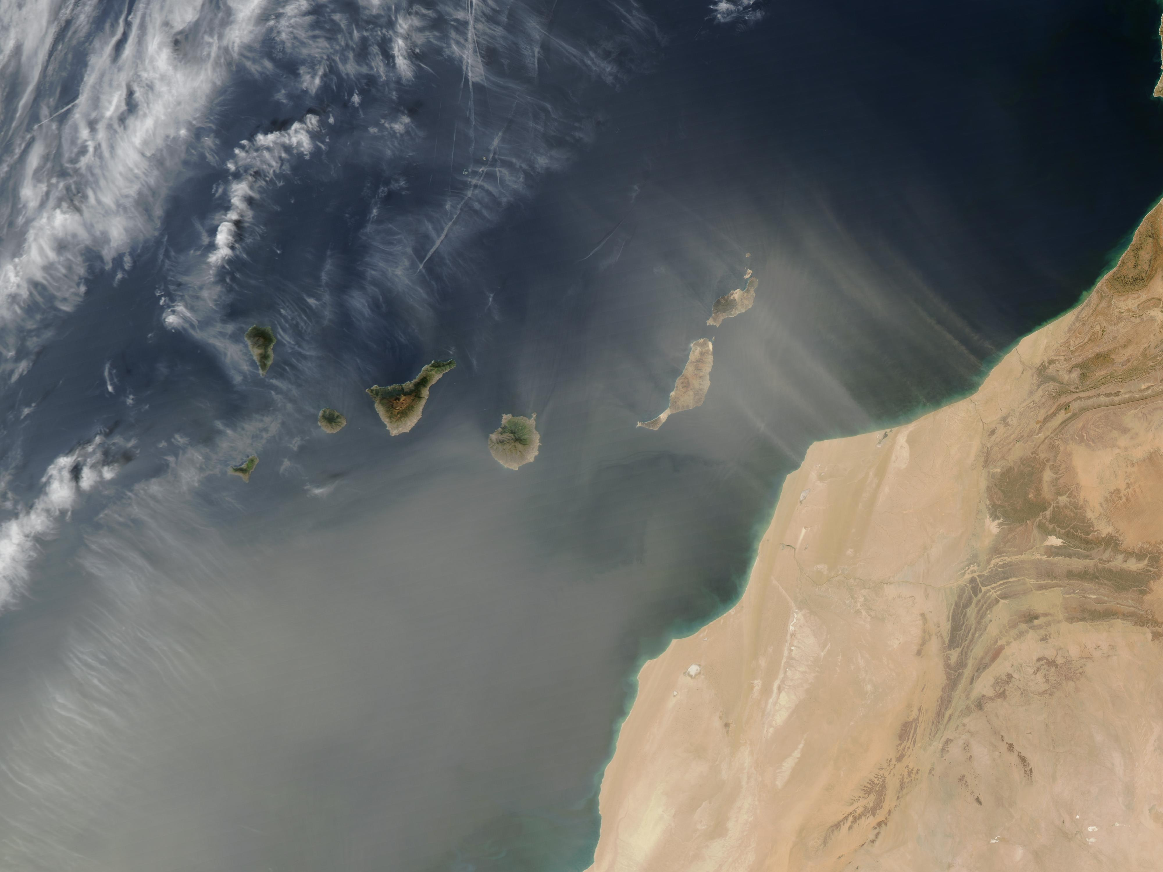

Slide 11
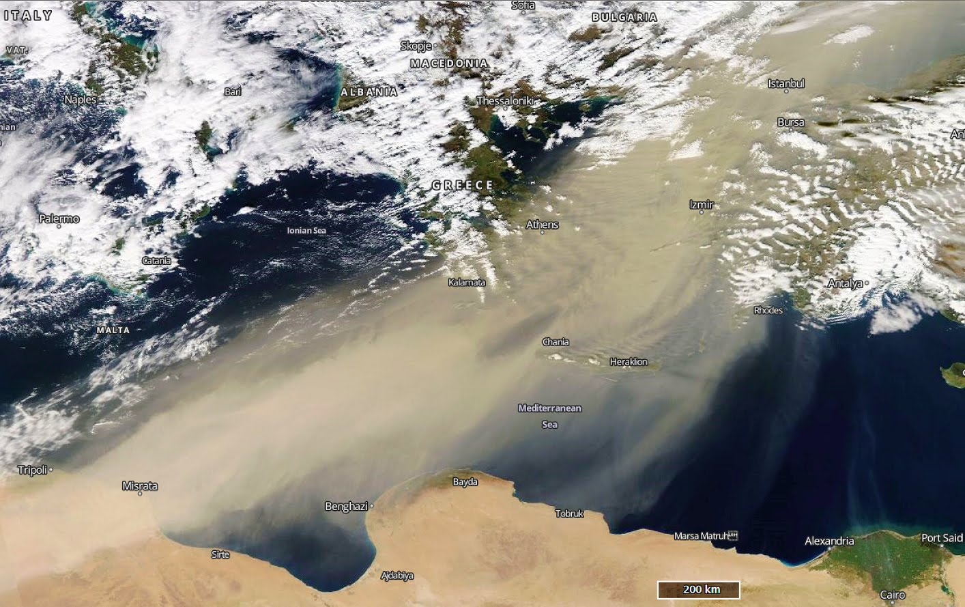

Slide 12
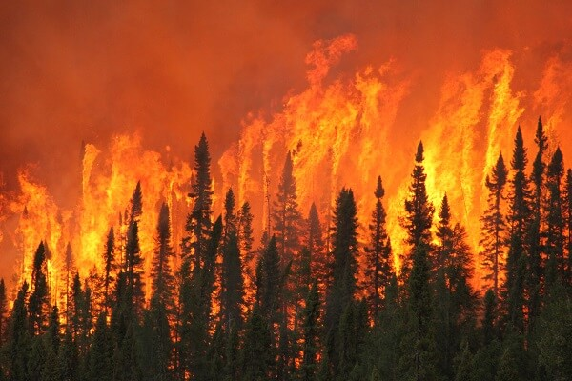
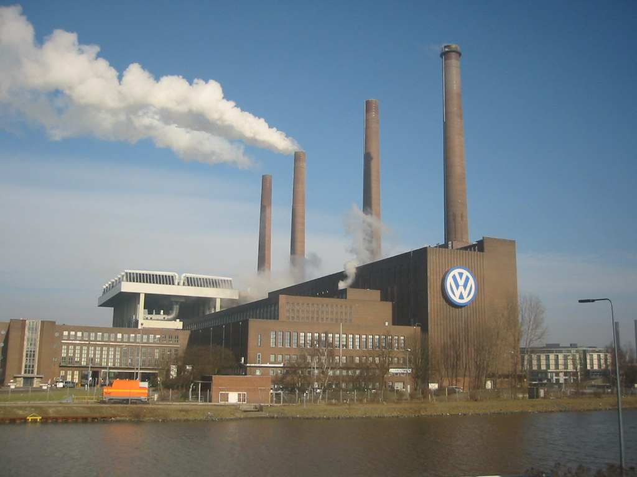
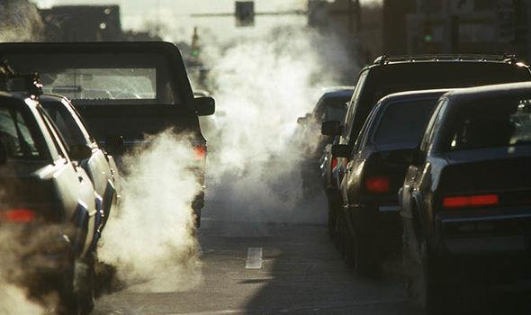
Sources of pollution
Where are these chemicals coming from? They can be produced naturally such as from forest fires, volcanoes, and sandstorms. They can also come from stationary sources. You can think of those as industrial such as factories. Finally, we have mobile sources such as cars and buses.

Slide 13
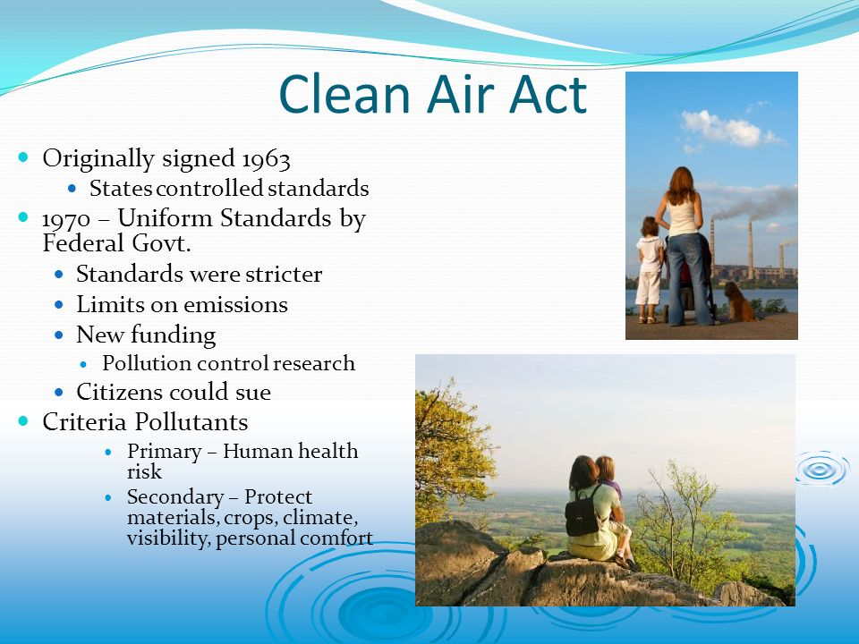

Slide 14
1990 Amendments to the Clean Air Act of 1970
- Authorized programs for Acid Deposition Control
Authorized a program to control 189 toxic pollutants, including those previously regulated by the National Emission Standards for Hazardous Air Pollutants
- Established permit program requirements
- Expanded and modified provisions concerning the attainment of National Ambient Air Quality Standards
- Expanded and modified enforcement authority
- Established a program to phase out the use of chemicals that deplete the ozone layer.
The EPA has set standards for the six criteria pollutants which include
1. Carbon Monoxide (CO)
2. Lead (Pb)
3. Nitrogen Dioxide (NO₂)
4. Ozone (O₃)
5. Particulate Matter (PM)
6. Sulfur dioxide (SO₂)

Slide 15
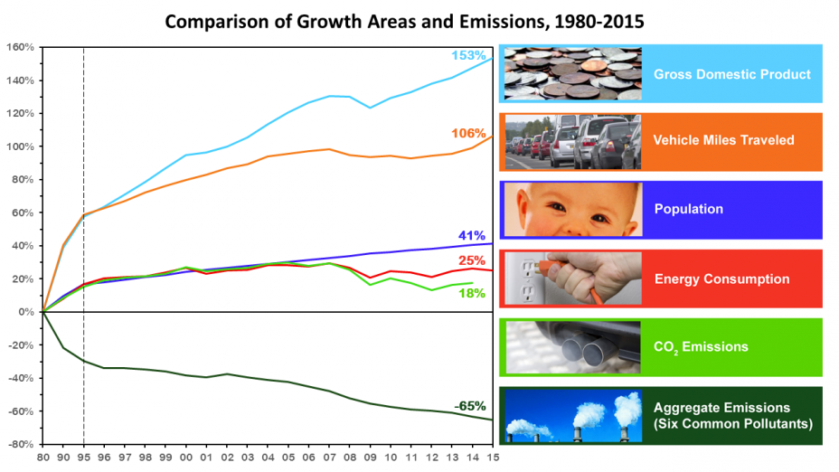

Slide 16
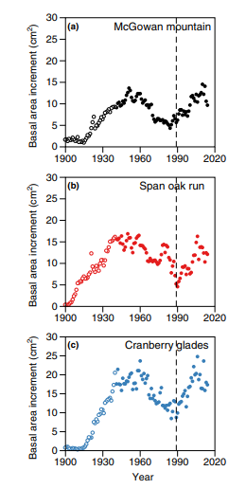
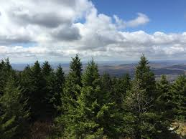
Biological Signatures
- In tree cores here taken from red spruce in WV, we can see growth change in response to the clean air act.
Matthis & Thomas, 2018

Slide 17
http://berkeleyearth.org/air-quality-real-time-map/

